Slide 1
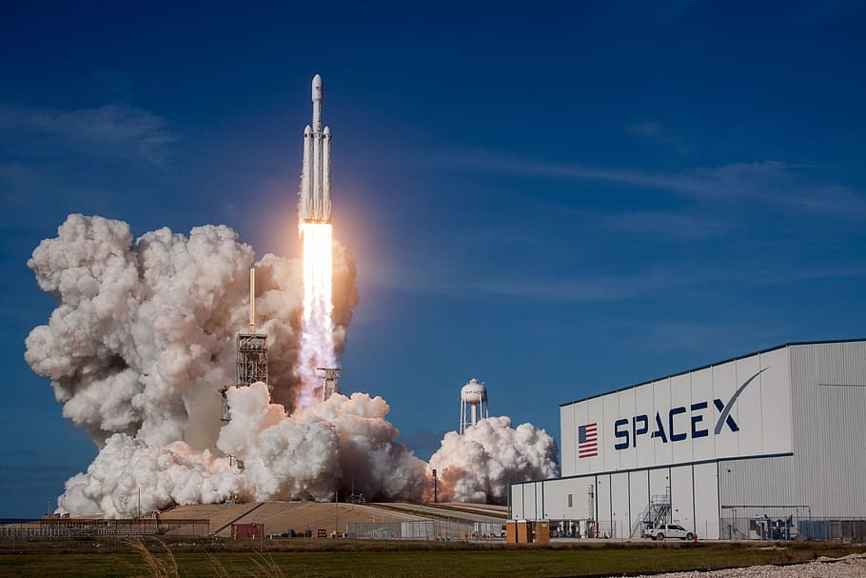

WINNING SPACE RACE WITH DATA SCIENCE
BY : RITU SINGH
25 SEPT 2022

Slide 2


Outline
Executive Summary
Introduction
Methodology
Results
Conclusion
Appendix

Slide 3

Executive Summary
Summary of methodologies
Data collection
Data wrangling
EDA with data visualization
EDA with SQL
Interactive map with Folium
Interactive Dashboard with Plotly Dash
Predictive Analysis (Classification)
Summary of results
Exploratory data analysis (EDA)
Interactive analytics demo in screenshots
Predictive analysis

Slide 4

Introduction
Project background and context
We predict if the Falcon 9 first stage will land successfully. SpaceX advertises Falcon 9 rocket launches on its website with a cost of 62 million dollars; other providers cost upward of 165 million dollars each, much of the savings is because SpaceX can reuse the first stage. Therefore if we can determine if the first stage will land, we can determine the cost of a launch. This information can be used if an alternate company wants to bid against SpaceX for a rocket launch.
Problems we want to find answers
What factors make launch successful.
What factors affect launch sites success rate.
Relationship between different variable and how they affect launch success rate.

Slide 5

Methodology

Slide 6
Methodology
Executive Summary
Data collection methodology: It can be done by two method :
By make a get request to the SpaceX API. And clean up the requested data.
By web scraping from Wikipedia.
Perform data wrangling
Data was cleaning, organizing, and transforming raw data into the desired format for analysts to use for prompt decision-making.
Perform exploratory data analysis (EDA) using visualization and SQL
Perform interactive visual analytics using Folium and Plotly Dash
Perform predictive analysis using classification models
How to build, tune, evaluate classification models

Slide 7
Data Collection
We would like to get a SpaceX data to predict whether Falcon 9 first stage will land successfully or not. For that 1st we do data collection by following steps :
We start with requesting rocket launch data from SpaceX REST API with a URL : https://api.spacexdata.com/v4/launches/past.
After converting the data into suitable format ,this API gives information about booster name, payload, launch site, landing outcomes, No. of flights, type of landing , about core and etc.
Another method by which we can obtain SpaceX data is by web scraping Wikipedia using BeautifulSoup.
Rest API
Web Site
(data source)
Extract data
using BeautifulSoup
Normalize data into .csv fie
SpaceX
data
Server
Json
SpaceX API
Web Scraping

Slide 8
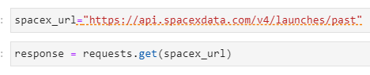
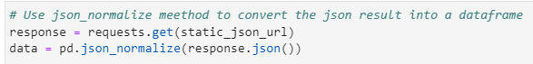
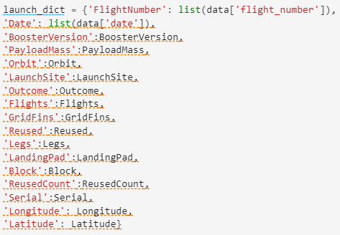
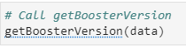
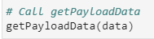
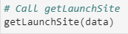
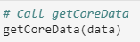
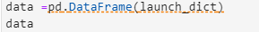
Data Collection – SpaceX API
(1) Request rocket launch data from SpaceX API :
(2) Decode the response content as a Json file :
(4) Create new dataframe
(3) Clean data by helper function :
(5) Filter the dataframe to only include Falcon 9 launch
(6) Convert file into .csv format :
https://github.com/Ritusingh1500/Applied-Data-Science-Capstone-/blob/5b1a0146b82db58339fc2988837dc475f2d11601/spacex-data-collection-api.ipynb

Slide 9
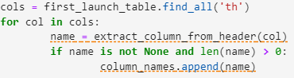
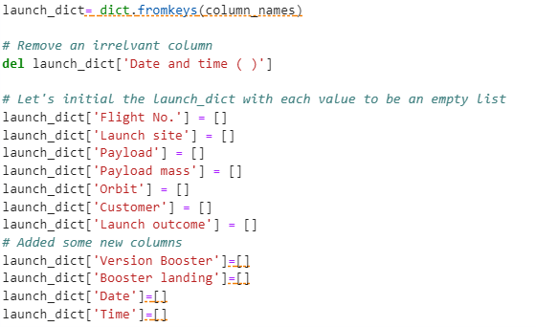
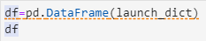
Data Collection - Scraping
HTTP GET method to request the Falcon9 Launch HTML page :
Create a BeautifulSoup object from the HTML response :
Extract table :
Extract column name :
(5) Create dictionary :
Create Dataframe from dictionary :
(7) Convert Dataframe file into .csv file :
https://github.com/Ritusingh1500/Applied-Data-Science-Capstone-/blob/5b1a0146b82db58339fc2988837dc475f2d11601/webscraping.ipynb

Slide 10
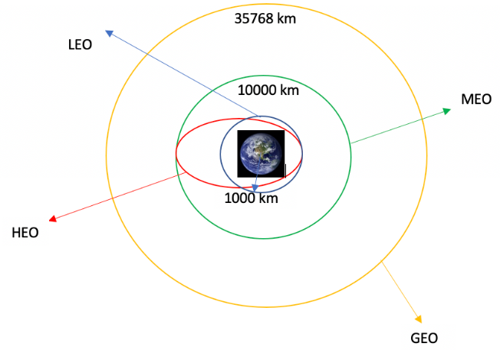
Data Wrangling
Data wrangling can be defined as the process of cleaning, organizing, and transforming raw data into the desired format for analysts to use for prompt decision-making.
With our data we will perform some Exploratory Data Analysis (EDA) to find some patterns in the data and determine what would be the label for training supervised models.
In the data set, there are several different cases where the booster did not land successfully. Sometimes a landing was attempted but failed due to an accident; for example, True Ocean means successfully landed to a specific region of the ocean while False Ocean means unsuccessfully landed to a specific region of the ocean. True RTLS means the mission outcome was successfully landed to a ground pad False RTLS means the mission outcome was unsuccessfully landed to a ground pad. True ASDS means the mission outcome was successfully landed to a drone ship False ASDS means the mission outcome was unsuccessfully landed to a drone ship. None ASDS and None None these represent a failure to land.
We will mainly convert those outcomes into Training Labels with `1` means the booster successfully landed `0` means it was unsuccessful.
Fig : Each launch aims to an dedicated orbit, and here are some common orbit types

Slide 11
Data Wrangling
The following steps were taken during data wrangling :
Load Space X dataset
And calculate percentage of missing value .
Calculate the number of launches on each site :
launch_sites=df['LaunchSite'].value_counts()
Calculate the number of landing outcomes :
landing_outcomes= df['Outcome'].value_counts()
Calculate the number and occurrence of each orbit :
df['Orbit'].value_counts()
Create a landing outcome label from Outcome column:
landing_class= []
for row in df['Outcome']:
if row in bad_outcomes:
landing_class.append(0)
else:
landing_class.append(1)
df['Class']=landing_class
df[['Class']].head(8)
Calculate success rate of landing_class :
df["Class"].mean()
Export the file into .csv format
https://github.com/Ritusingh1500/Applied-Data-Science-Capstone-/blob/0b82af432f215898c8eb1bf6630ed0767f5cd197/spacex-Data%20wrangling.ipynb

Slide 12



EDA with Data Visualization
SCATTER PLOT LINE PLOT
FlightNumber vs PayloadMass (1) Plot of Launch success yearly trend.
FlightNumber vs LaunchSite Line graphs are used to track changes over short and long periods of
PayLoad vs LaunchSite time.
FlightNumber vs Orbit
PayLoad vs Orbit
A scatter diagram visualizes the relationship between
two variables and how they are correlated.
A scatter diagram is one of the best tools for
Large data and to show a non-linear pattern .
BAR PLOT
Success Rate vs Orbit
The bar graph helps to compare the different
sets of data among different groups easily.
https://github.com/Ritusingh1500/Applied-Data-Science-Capstone-/blob/874803ce50c6ddbe151700719a3d6ea5ebc6860d/eda-dataviz.ipynb

Slide 13

EDA with SQL
Performed SLQ queries to find insights of dataset.
Following are the queries asked :
Display the names of the unique launch sites in the space mission.
Display 5 records where launch sites begin with the string 'CCA‘.
Display the total payload mass carried by boosters launched by NASA (CRS)
Display average payload mass carried by booster version F9 v1.1
List the date when the first succesful landing outcome in ground pad was acheived.
List the names of the boosters which have success in drone ship and have payload mass greater than 4000 but less than 6000
List the total number of successful and failure mission outcomes
List the names of the booster_versions which have carried the maximum payload mass. Use a subquery
Rank the count of successful landing_outcomes between the date 04-06-2010 and 20-03-2017 in descending order.
List the records which will display the month names, failure landing_outcomes in drone ship ,booster versions, launch_site for the months in year 2015.
https://github.com/Ritusingh1500/Applied-Data-Science-Capstone-/blob/f2adf5c03d8e535f7a319b7b18477aa3b8e39965/eda-sql-coursera_sqllite%20(1).ipynb

Slide 14

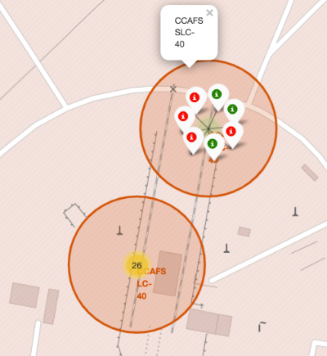
Interactive Map with Folium
The launch success rate depend on the location and proximities of a launch site, i.e., the initial position of rocket trajectories. Finding an optimal location for building a launch site certainly involves many factors and we could discover some of the factors by analyzing the existing launch site locations. Hence we perform interactive visual analytics using Folium.
Folium provides the folium.Map( ) class which takes site’s location parameter in terms of latitude and longitude and generates a map around it.
folium.Circle( ) class is used to add a highlighted circle area with a text label on a specific coordinate.
folium.Marker( ) class is used to mark specific locations. We used marker for all launch records like green marker for successful launch and red marker for unsuccessful launch.
Folium.MarkerCluster( ) class is used to simplify a map containing many markers having the same coordinate.
Added `MousePosition` on the map to get coordinate for a mouse over a point on the map.
We can use markers to specific certain locations like hospitals , Police stations, schools etc.
Marker
Marker Cluster
Circle
https://github.com/Ritusingh1500/Applied-Data-Science-Capstone-/blob/aba58282f594d76e6d2c706ee6012d5a33dc3cce/launch_site_location.ipynb

Slide 15
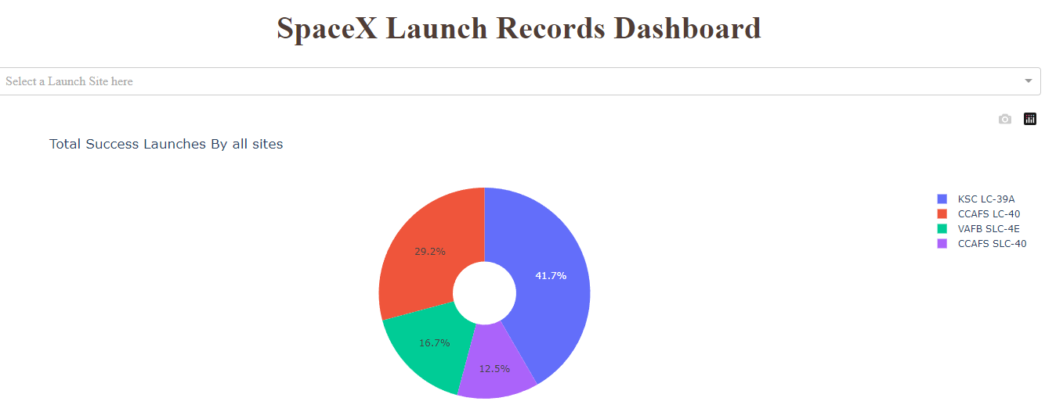
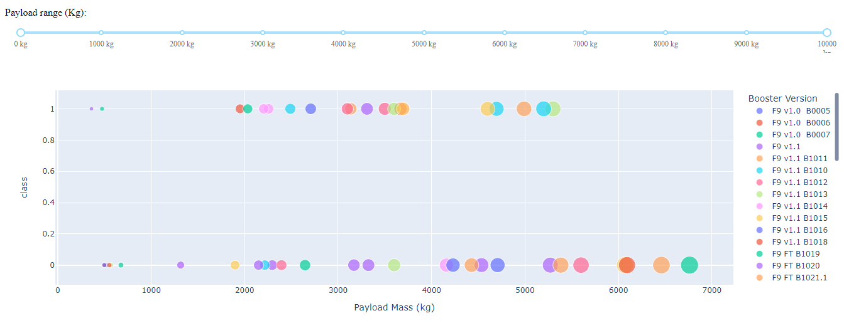
Interactive Dashboard with Plotly Dash
Our dashboard application contains input components such as a dropdown list and a range slider to interact with a pie chart and a scatter point chart.
Launch Site Drop-down
dropdown menu so that we can select different launch sites.
PIE CHART
It shows the success rate of each launch site . It is the best way to visualize success rate of launch site’s.
SCATTER PLOT
It is a success payload scatter chart . It basically show how payload may be correlated with mission outcomes for selected site’s.
By analyzing dashboard we can find useful insights like:
Which site has the largest successful launches?
Which site has the highest launch success rate?
Which payload range(s) has the highest launch success rate?
Which payload range(s) has the lowest launch success rate?
Which F9 Booster version (v1.0, v1.1, FT, B4, B5, etc.) has the highest
launch success rate?
https://u1508ritusin-8050.theiadocker-3-labs-prod-theiak8s-4-tor01.proxy.cognitiveclass.ai/
https://github.com/Ritusingh1500/Applied-Data-Science-Capstone-/blob/1b5a43336d52223c9c9239e62866ed421ffaa411/spacex_dash_app%20(1).py

Slide 16
Predictive Analysis (Classification)
We create a machine learning pipeline to predict if the first stage will land or not.
In our test dataset we found that decision tree method having the best accuracy with 88 % .
Load the dataframe and create a column class in data
Standardize the data in X and reassign X:
X= preprocessing.StandardScaler().fit(X).transform(X)
split the data into training and testing data using the function train_test_split :
X_train, X_test, Y_train, Y_test = train_test_split(X, Y, test_size=0.2, random_state=2)
Create Classification algorithms like logistic regression, Support Vector Machine (SVM), Decision Tree, K-Nearest Neighbor (KNN) and fit the object to find best parameter.
Find the method perform best using .score() function
https://github.com/Ritusingh1500/Applied-Data-Science-Capstone-/blob/17789397b5aeb54158f53c5493322ad580b43bd2/SpaceX_Machine%20Learning%20Prediction_Part_5.ipynb

Slide 17

Results
Exploratory data analysis (EDA)
Interactive analytics demo
in screenshots
Predictive analysis

Slide 18

EDA Data Visualization

Slide 19
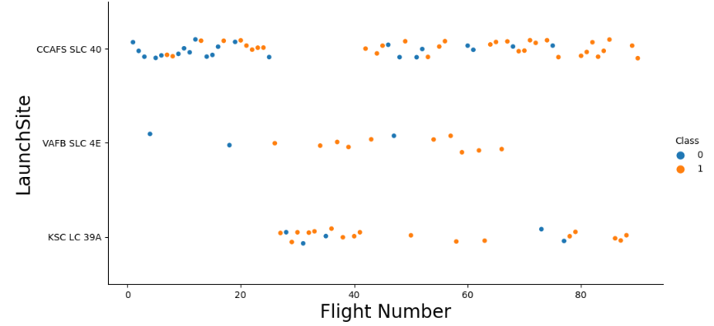
Flight Number vs. Launch Site
Conclusion :
Launch Site with Flight Number greater then 20 show better success rate of successful rocket landing.
Launch site VAFB SLC 4E and KSC LC 39A have better success rate with around 77 % . As comparing to CCFS SCL 40 launch site.
Flight number above 20 show better success rate.

Slide 20
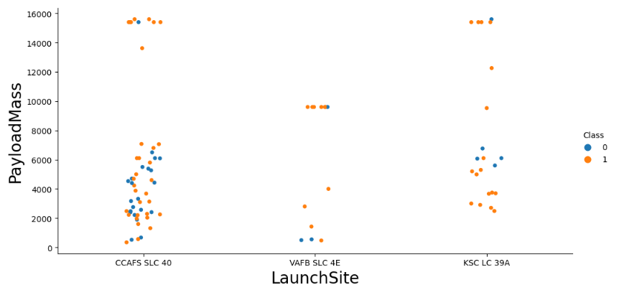
Payload vs. Launch Site
Conclusion :
We can say that for VAFB-SLC launch site there are no rockets launched for heavy payload mass(greater than 10000).
Launch site’s have better success rate for payload mass greater then 8000.

Slide 21
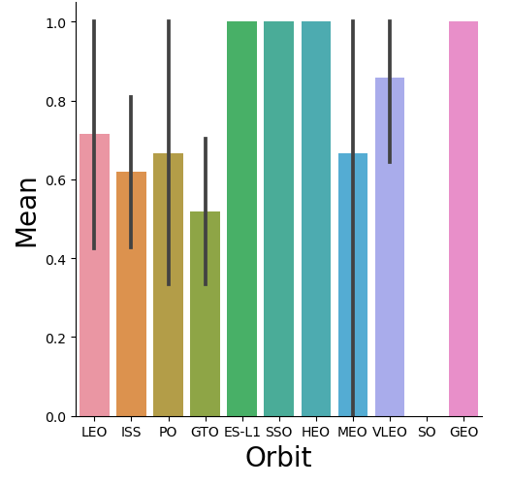
Success Rate vs. Orbit Type
Conclusion :
Orbit ES-L1, SSO, HEO, GEO have best success rate while GTO have worst success rate .

Slide 22
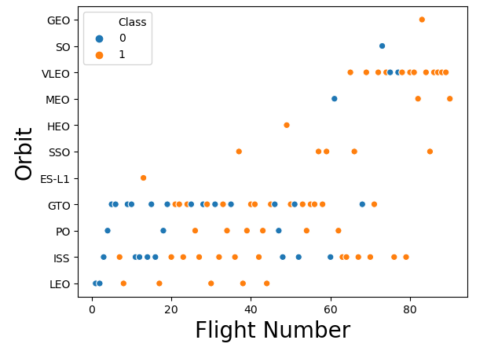
Flight Number vs. Orbit Type
Conclusion :
We can’t see a clear relationship between Orbit and flight number. But we can say that LEO and VLEO orbit have high success rate and GTO orbit have lowest success rate.

Slide 23
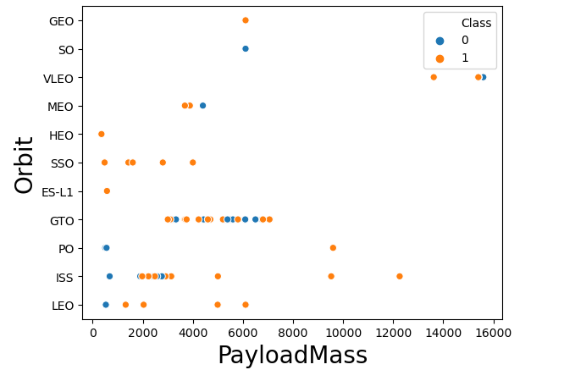
Payload vs. Orbit Type
Conclusion :
We can say that with heavy payloads the successful landing or positive landing rate are more for Polar, LEO and ISS.
However for GTO we cannot distinguish this well as both positive landing rate and negative landing(unsuccessful mission) are both there here.

Slide 24
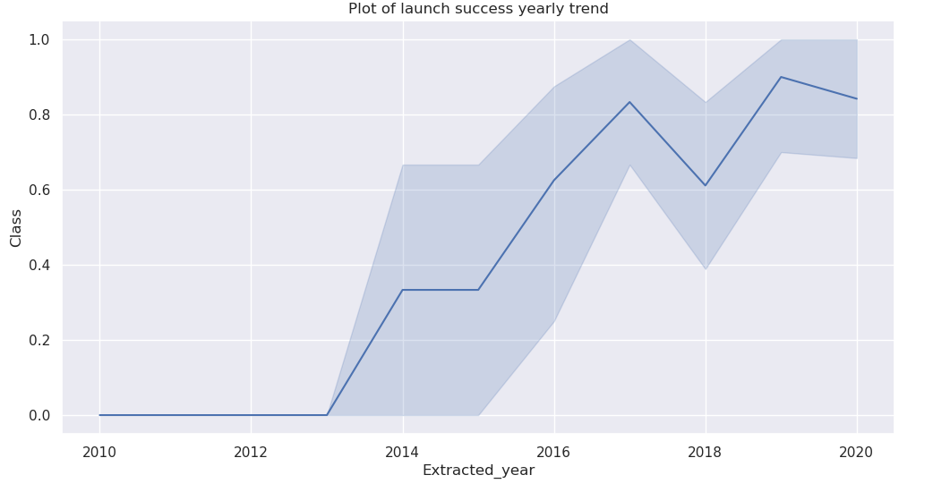
Launch Success Yearly Trend
Conclusion :
The success rate since 2013 kept increasing till 2020

Slide 25

Exploratory data analysis with SQL

Slide 26
All Launch Site Names
SQL Query
the names of the unique launch sites in the space mission
%sql select DISTINCT(LAUNCH_SITE) from SPACEXTBL;
Launch_Site
CCAFS LC-40
VAFB SLC-4E
KSC LC-39A
CCAFS SLC-40
Query Explanation :
Select function is used to find certain data like here launch site and DISTINCT function is used to find unique name of launch sites from SPACEXTBL dataset.

Slide 27
Launch Site Names Begin with 'CCA'
SQL Query
Display 5 records where launch sites begin with the string 'CCA'
%sql SELECT * from SPACEXTBL where (LAUNCH_SITE) LIKE 'CCA%' LIMIT 5;
date | Time (UTC) | Booster_Version | Launch_Site | Payload | PAYLOAD_MASS__KG_ | Orbit | Customer | Mission_Outcome | Landing _Outcome
04-06-2010 | 18:45:00 | F9 v1.0 B0003 | CCAFS LC-40 | Dragon Spacecraft Qualification Unit | 0 | LEO | SpaceX | Success | Failure (parachute)
08-12-2010 | 15:43:00 | F9 v1.0 B0004 | CCAFS LC-40 | Dragon demo flight C1, two CubeSats, barrel of Brouere cheese | 0 | LEO (ISS) | NASA (COTS) NRO | Success | Failure (parachute)
22-05-2012 | 07:44:00 | F9 v1.0 B0005 | CCAFS LC-40 | Dragon demo flight C2 | 525 | LEO (ISS) | NASA (COTS) | Success | No attempt
08-10-2012 | 00:35:00 | F9 v1.0 B0006 | CCAFS LC-40 | SpaceX CRS-1 | 500 | LEO (ISS) | NASA (CRS) | Success | No attempt
01-03-2013 | 15:10:00 | F9 v1.0 B0007 | CCAFS LC-40 | SpaceX CRS-2 | 677 | LEO (ISS) | NASA (CRS) | Success | No attempt
Query Explanation :
SELECT (*) function is use to show all columns from SPACEXTBL dataset.
And where function is used to filter data with condition LIKE 'CCA%' LIMIT 5 to show launch site whose launch site name start with CCA string with record limit 5.

Slide 28
Total Payload Mass
SQL Query
Display the total payload mass carried by boosters launched by NASA (CRS)
%sql select customer, sum(PAYLOAD_MASS__KG_) as total_payload_mass from SPACEXTBL where CUSTOMER = 'NASA (CRS)';
Query Explanation :
In this code customer and sum(PAYLOAD_MASS_KG) is selected with in sum function is used find total payload mass whose booster launched is by NASA (CRS) from SPACEXTBL dataset
Customer | total_payload_mass
NASA (CRS) | 45

Slide 29
Average Payload Mass by F9 v1.1
SQL Query
Display average payload mass carried by booster version F9 v1.1
%sql select BOOSTER_VERSION, avg(PAYLOAD_MASS__KG_) as average_payload_mass from SPACEXTBL where BOOSTER_VERSION ='F9 v1.1';
Query Explanation :
In this code select BOOSTER_VERSION,avg(PAYLOAD_MASS_KG) in which avg function is used to find average of payload mass and where function is to filter with the condition having booster version F9 v1.1
Booster_Version | average_payload_mass
F9 v1.1 | 29

Slide 30
First Successful Ground Landing Date
SQL Query
List the date when the first successful landing outcome in ground pad was achieved.
%sql SELECT MIN(DATE) AS "First Succesful Landing Outcome in Ground Pad" FROM SPACEXTBL WHERE "LANDING__OUTCOME" = 'Success (ground pad)';
Query Explanation :
In this code we select min(DATE) where min function is used to show minimum date and where function is to filter with the condition LANDING_OUTCOME=success(ground pad) which gives successful landing outcome in ground pad in SPACEXTBL dataset
First Succesful Landing Outcome in Ground Pad
2015-12-22

Slide 31
Successful Drone Ship Landing with Payload between 4000 and 6000
SQL Query
List the names of the boosters which have success in drone ship and have payload mass greater than 4000 but less than 6000
%sql select BOOSTER_VERSION from SPACEXTBL where MISSION_OUTCOME = 'Success (drone ship)' \
AND PAYLOAD_MASS__KG_ > 4000 AND PAYLOAD_MASS__KG_ < 6000;
Query Explanation :
In this code select BOOSTER_VERSION is use to find booster version ,where with a condition of having MISSION_OUTCOME = 'Success (drone ship)' for successful drone ship mission outcome and PAYLOAD_MASS__KG_ > 4000 AND PAYLOAD_MASS__KG_ < 6000 for having payload mass between 4000 to 6000
booster_version
F9 FT B1022
F9 FT B1026
F9 FT B1021.2
F9 FT B1031.2

Slide 32
Total Number of Successful and Failure Mission Outcomes
SQL Query
List the total number of successful and failure mission outcomes.
%sql SELECT sum(case when MISSION_OUTCOME LIKE '%Success%' then 1 else 0 end) AS "Successful Mission", \
sum(case when MISSION_OUTCOME LIKE '%Failure%' then 1 else 0 end) AS "Failure Mission" \
FROM SPACEXTBL;
Query Explanation :
In this code select sum(case when MISSION_OUTCOME LIKE '%Success%' then 1 else 0 end) AS "Successful Mission” is used to show sum all mission outcome with success result. And also select sum(case when MISSION_OUTCOME LIKE '%Failure%' then 1 else 0 end) AS "Failure Mission" is used to show sum of all the mission outcome with failure result from SPACEXTBL dataset.
Successful Mission | Failure Mission
100 | 1

Slide 33
Boosters Carried Maximum Payload
SQL Query
List the names of the booster_versions which have carried the maximum payload mass.
%sql select BOOSTER_VERSION as booster_version from SPACEXTBL where PAYLOAD_MASS__KG_=(select max(PAYLOAD_MASS__KG_) from SPACEXTBL);
booster_version
F9 B5 B1048.4
F9 B5 B1049.4
F9 B5 B1051.3
F9 B5 B1056.4
F9 B5 B1048.5
F9 B5 B1051.4
F9 B5 B1049.5
F9 B5 B1060.2
F9 B5 B1058.3
F9 B5 B1051.6
F9 B5 B1060.3
F9 B5 B1049.7
Query Explanation :
Select BOOSTER_VERSION which we are finding .where PAYLOAD_MASS_KG = (select max(PAYLOAD_MASS_KG) is use to filter data with condition of having maximum payload mass from SPACEXTBL dataset.

Slide 34
2015 Launch Records
SQL Query
List the records which will display the month names, failure landing_outcomes in drone ship ,booster versions, launch_site for the months in year 2015.
%sql SELECT "monthname(DATE)" as Month, BOOSTER_VERSION, LAUNCH_SITE FROM SPACEXTBL WHERE "year(DATE)" = '2015' AND "LANDING__OUTCOME" = 'Failure (drone ship)';
Query Explanation :
In this code Select monthname(DATE) , BOOSTER_VERSION, LAUNCH_SITE which we want to find from SPACEXTBL dataset . monthname(DATE) function dispay month name from the date.And where is used to impose condition like "year(DATE)" = '2015' AND "LANDING__OUTCOME" = 'Failure (drone ship)'; which means year should be 2015 and landing outcome should be failure in drone ship .
Month | booster_version | launch_site
January | F9 v1.1 B1012 | CCAFS LC-40
April | F9 v1.1 B1015 | CCAFS LC-40

Slide 35
Rank Landing Outcomes Between 2010-06-04 and 2017-03-20
SQL Query
Rank the count of successful landing_outcomes between the date 04-06-2010 and 20-03-2017 in descending order.
%sql SELECT "LANDING__OUTCOME" AS "Landing outcome" COUNT("LANDING__OUTCOME") AS "Rank of successful landing between 2010-06-04 and 2017-03-20" FROM SPACEXTBL WHERE"LANDING__OUTCOME" LIKE '% Success %‘ AND DATE BETWEEN '2010-06-04' AND '2017-03-20' GROUP BY "LANDING__OUTCOME" ORDER BY COUNT("LANDING__OUTCOME") DESC;
Query Explanation :
In this code SELECT "LANDING__OUTCOME" ,COUNT(“LANDING_OUTCOME) ,count function is used to count no of landing outcome. WHERE function is use to impose "LANDING__OUTCOME" LIKE '%Success%' AND DATE > '2010-06-04' AND DATE < '2017-03-20' condition which means count landing outcomes whose result contain success word and having date between 04-06-2010 and 20-03-2017. GROUP BY "LANDING__OUTCOME" function is used to group landing outcome and ORDER BY COUNT("LANDING__OUTCOME") DESC function is used to count landing outcome in descending order.
Landing outcome | Rank of successful landing between 2010-06-04 and 2017-03-20
Success (drone ship) | 5
Success (ground pad) | 3

Slide 36

Launch sites Proximities Analysis

Slide 37
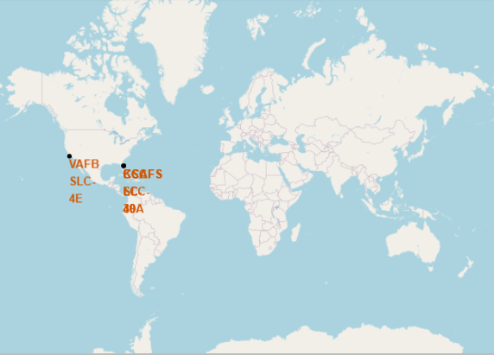
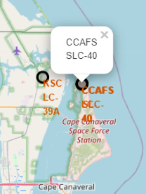
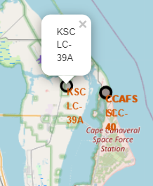
ALL LAUNCH SITE
World map showing all Launch site of SpaceX . We can see all launch site are around coastal area of USA.
Zoomed images

Slide 38
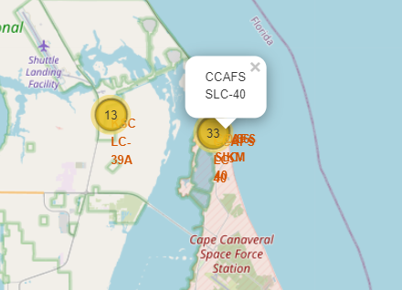
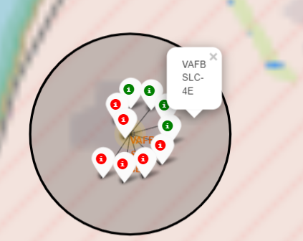
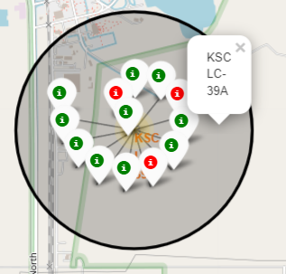
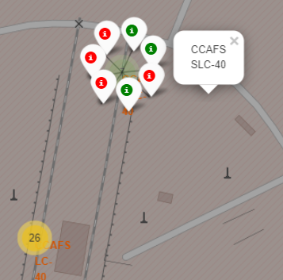
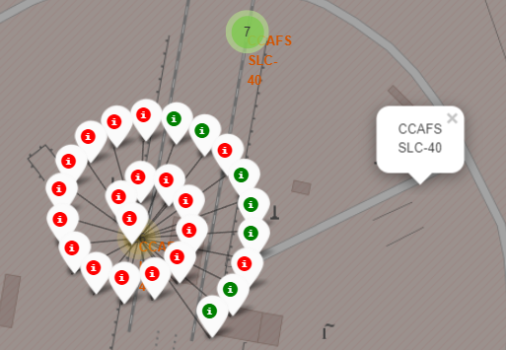
MARKED LAUNCH SITES
Yellow circle is a marked cluster which indicate sites are very close to each other. So all close site indicate by single one circle and number inside circle represent number of sites in that place.
Green marker indicate successful launch and red marker show unsuccessful launch . By that we can find which launch site have greater success rate

Slide 39
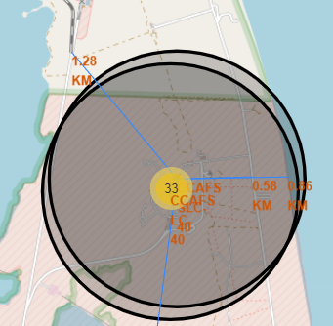
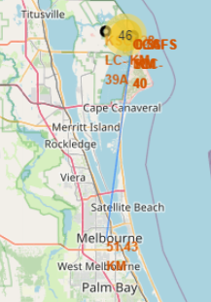
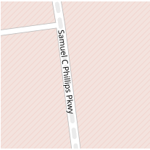


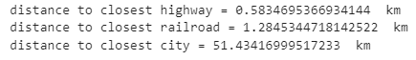
INSIGHTS OF LAUNCH SITES
Distance to Closed railway
Closed highway symbol
Closed Railway symbol
Distance to closed coastline
Closed city distance
Distance to closed highway
Closed City symbol
By analyzing maps we can answer following things :
Are launch sites in close proximity to railways?
Are launch sites in close proximity to highways?
Are launch sites in close proximity to coastline?
Do launch sites keep certain distance away from cities?

Slide 40

Interactive analytics with Dashboard

Slide 41
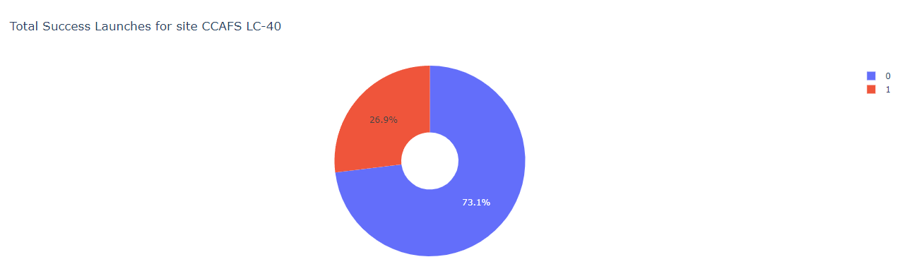
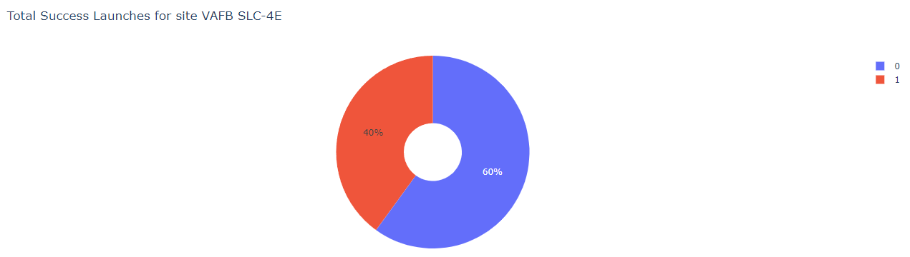
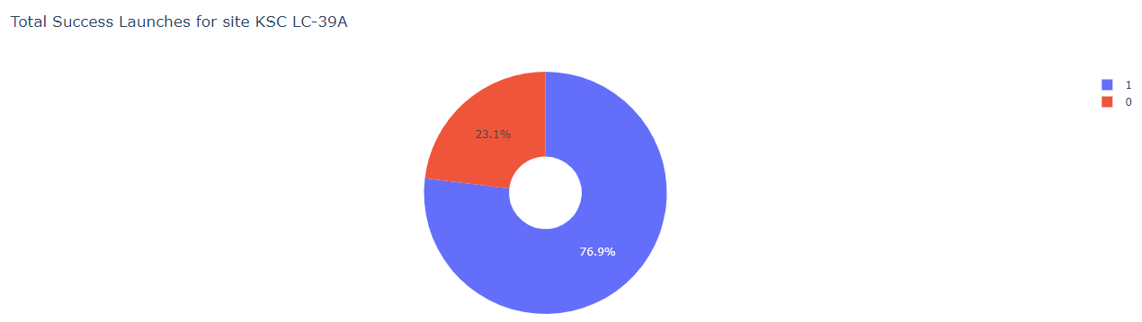
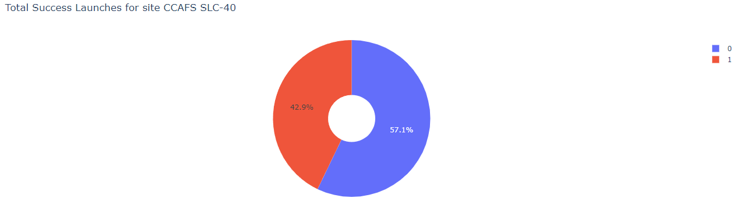
PEICHART LAUNCH SUCCESS COUNT
VAFB SLC - 4E has 60% success rate
KSC LC – 39A has 76.9% success rate CCAFS SLC – 40 has 57.1% success rate
CCAFS LC - 40 has 73.1% success rate

Slide 42
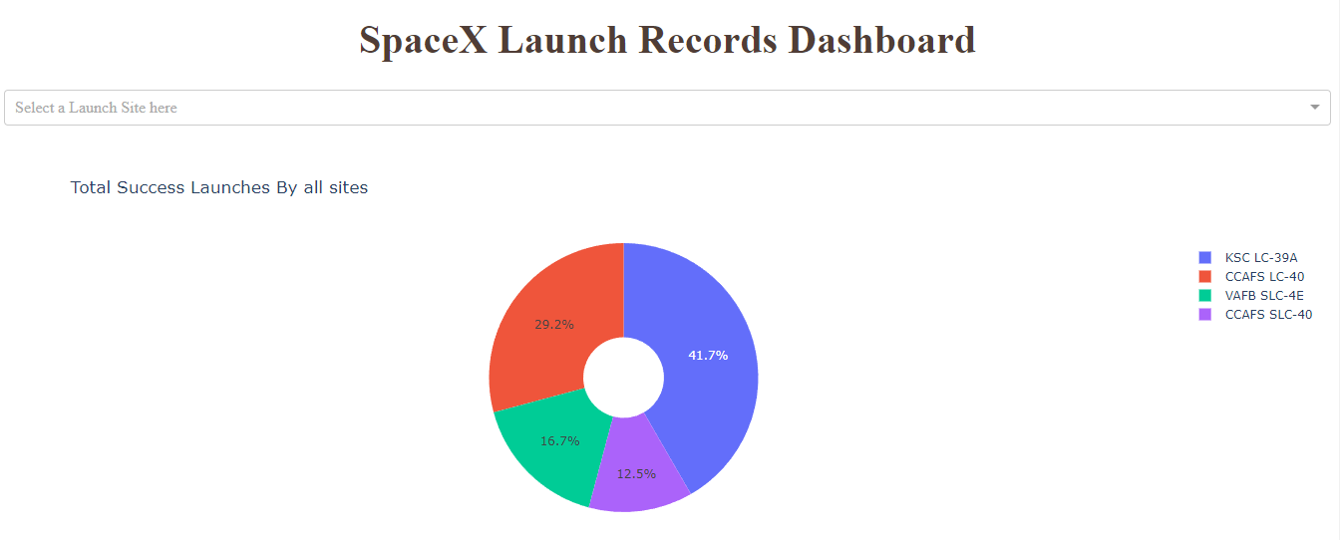
PEICHART FOR ALL LAUNCH SITES
Conclusion
Pie chart shows that KSC LC- 39A has the highest success rate of 41.2% from all the launch sites.

Slide 43
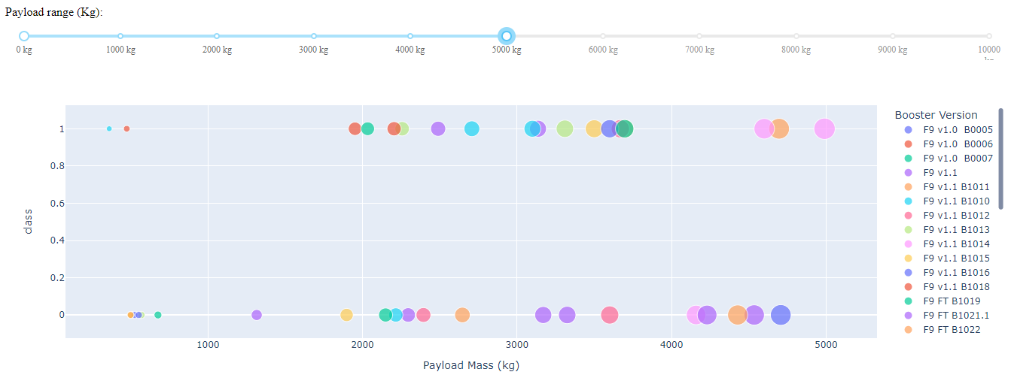
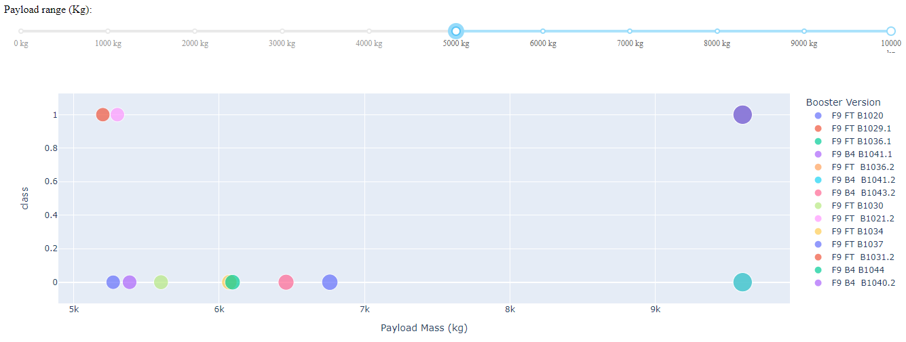
Payload vs. Launch Outcome scatter plot >
For payload range 0kg – 5000kg For payload range 5000kg -10000kg
Conclusion
We can see success rate is higher for lower payload mass range as comparing to higher payload mass range

Slide 44

PREDICTIVE ANALYSIS
(CLASSIFICATION)

Slide 45
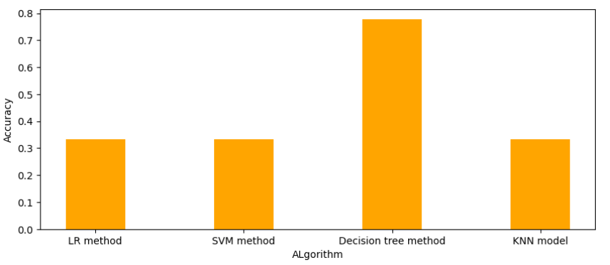
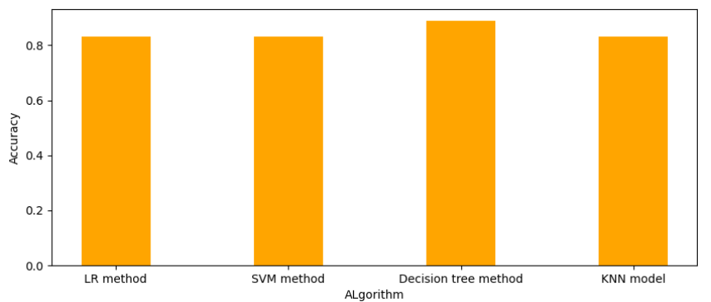
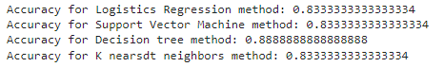
Classification Accuracy
Methods accuracy values :
We can say that decision tree method is the best classification method with 0.888 accuracy . It means decision tree method is best to use in analyics.

Slide 46
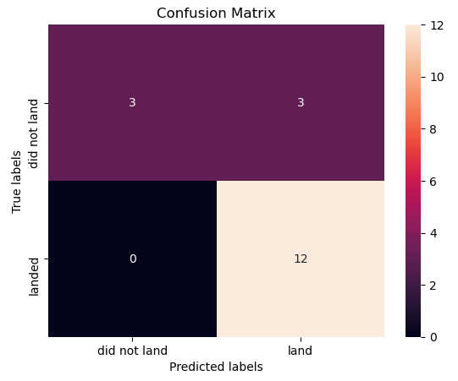
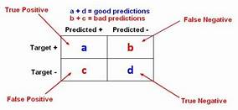
Confusion Matrix
A confusion matrix is a table that is used to define the performance of a classification algorithm.
This is the decision tree confusion matrix. We can distinguish between the different classes. We see that the major problem is false positive.

Slide 47

Conclusions
Launch Site with Flight Number greater then 20 show better success rate of successful rocket landing.
Launch success rate is higher for lower payload mass range as comparing to higher payload mass range.
Orbit ES-L1, SSO, HEO, GEO have best success rate while GTO have worst success rate .
With heavy payloads the successful landing or positive landing rate are more for Polar, LEO and ISS.
KSC LC – 39A has highest successful launch sites.
Decision tree method is best classification method to use.

Slide 48
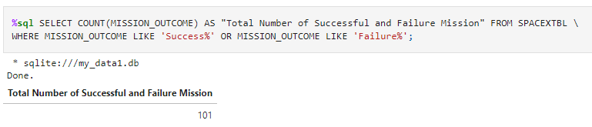
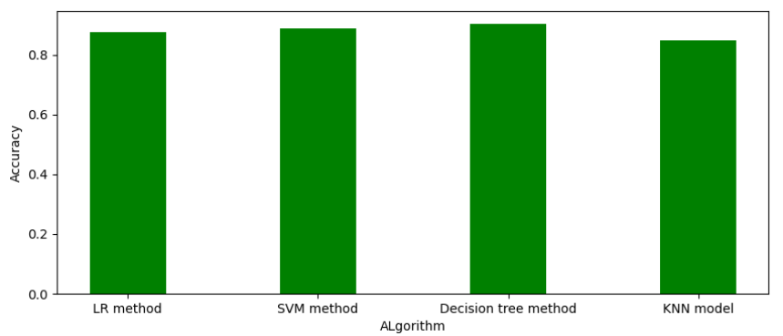
Appendix
Did some Google research on data collection, data wrangling, confusion matrix etc.
Use to show combine mission outcomes
Observe bar chart of training Data set

Slide 49
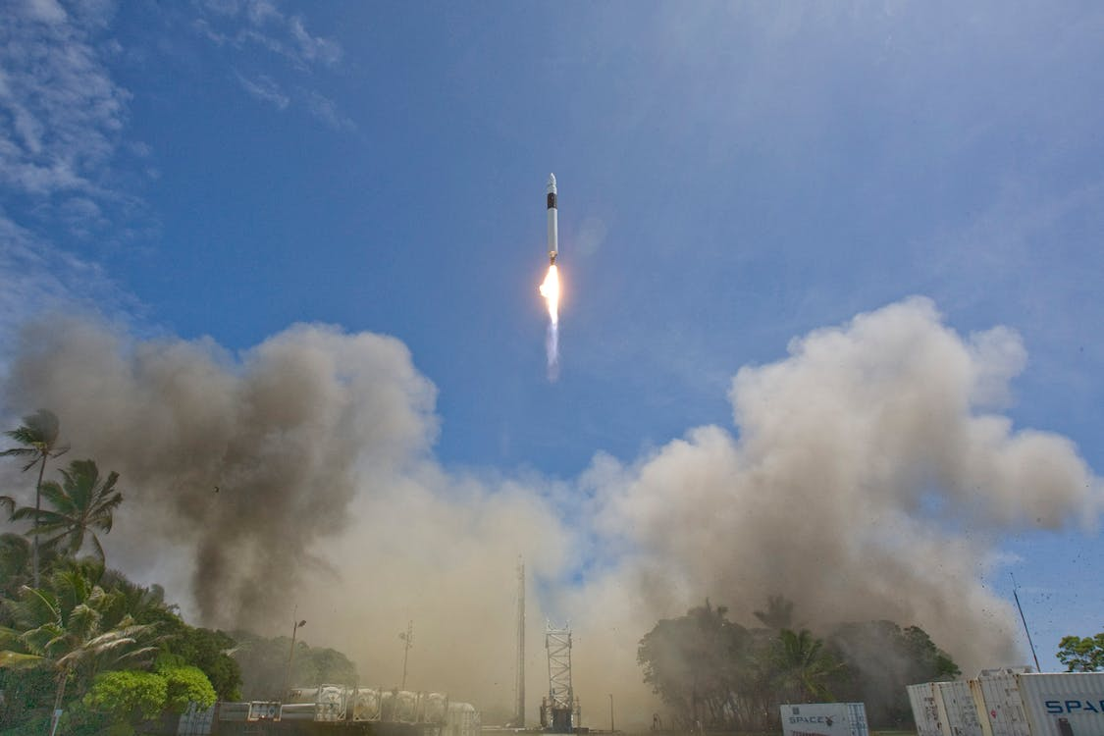
THANK YOU !

